Slide 1
Project 4 -MNIST
By Aaron Bilbow and Adam Mayer

Slide 2
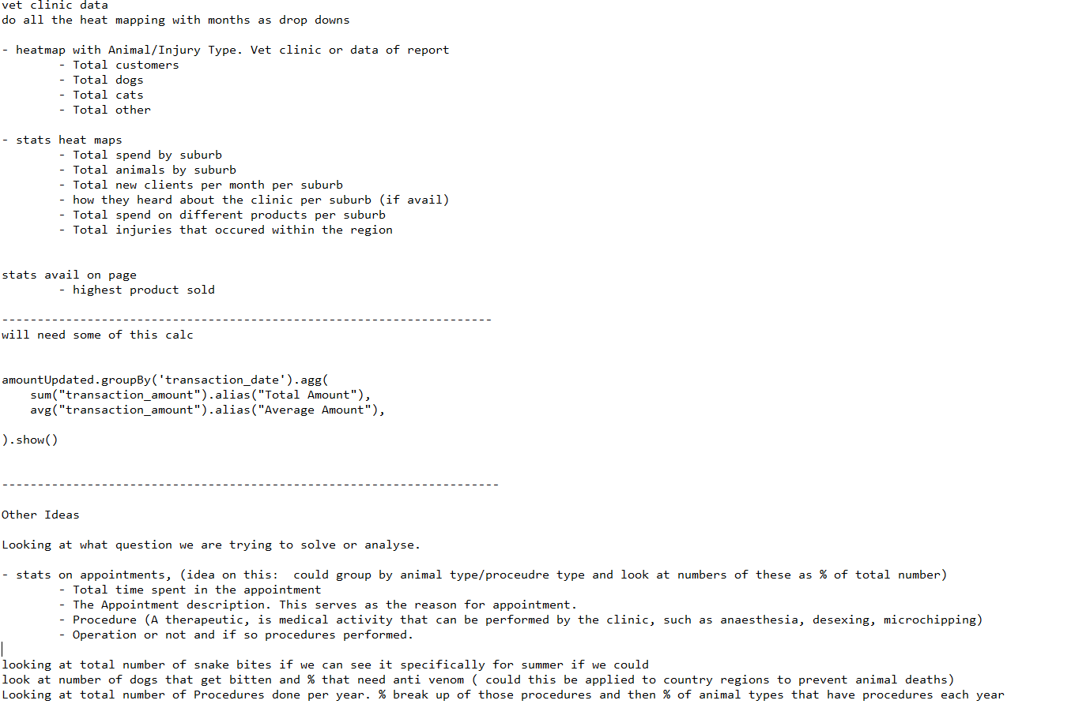
The original idea.
Vet Clinic Api calls
Heat map with statistics
User interface(driven)
Animal Injury type
Country Town Split

Slide 3
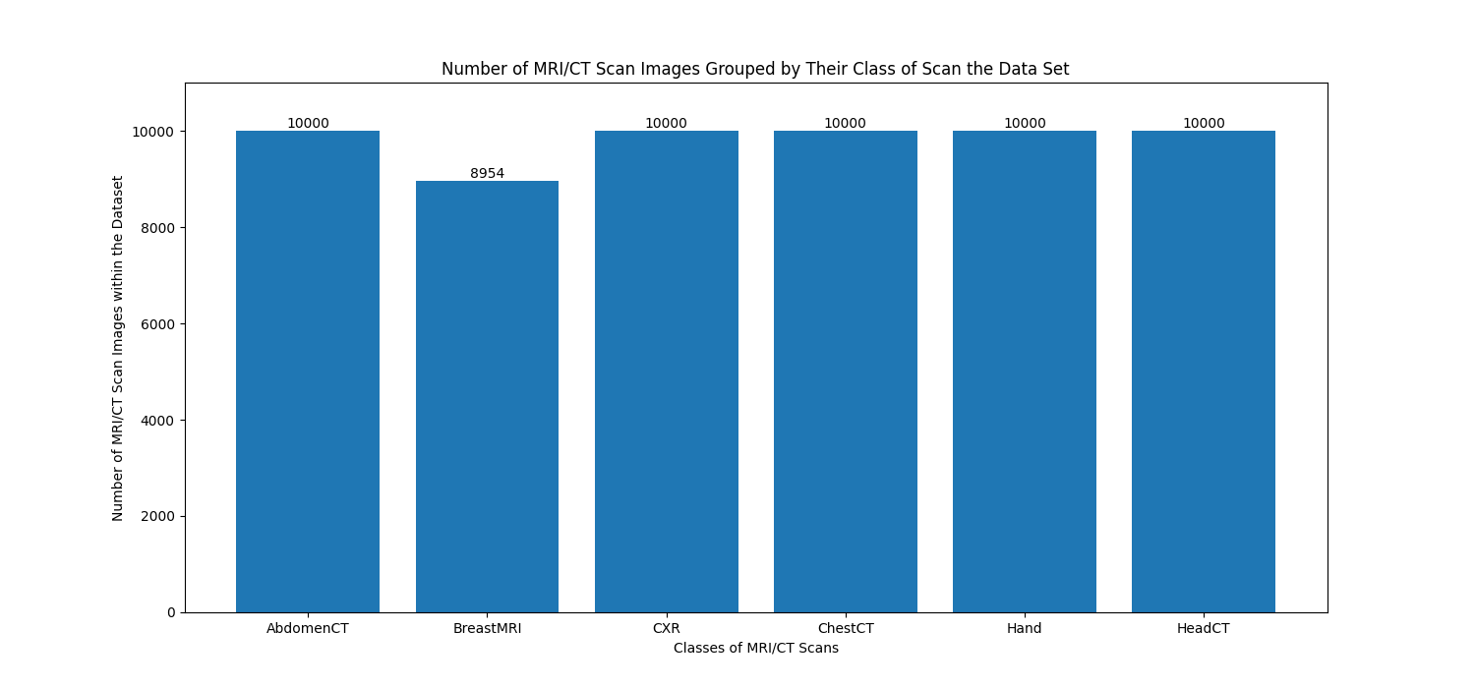
MNIST Dataset
Large Dataset found
Project Proposal was re written.
Problem/Aim- identify new images and sort… for the future.

Slide 4
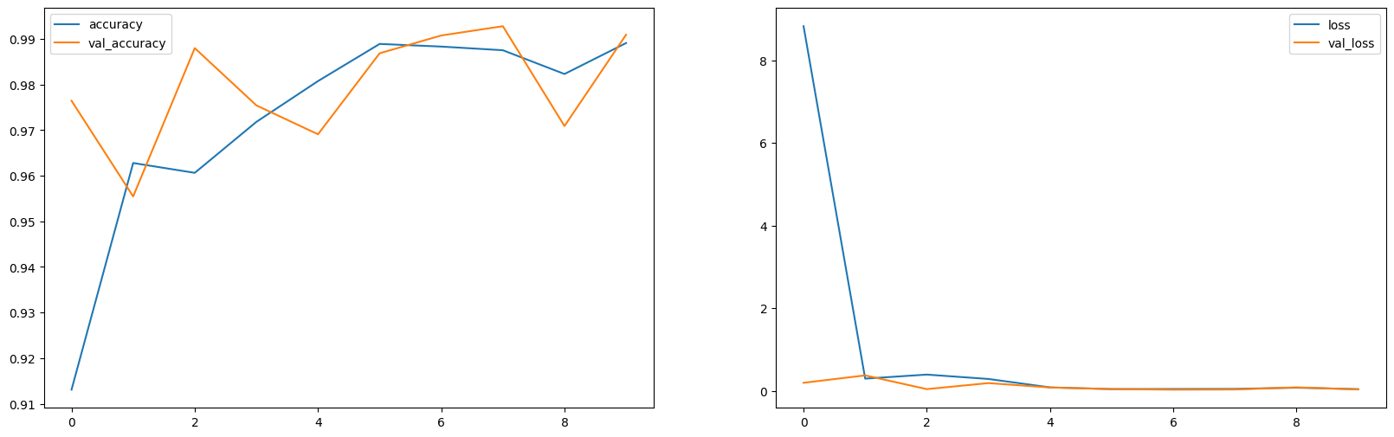
Results

Slide 5
Analysis and Future Questions
Accuracy of 0.9891% after 10 cycles
Loss of 0.0434
Validation Accuracy of 0.9909%.
Validation loss of 0.0359
Possible over fitting?
Future Models?
Limitations- only 6 classes

Slide 6
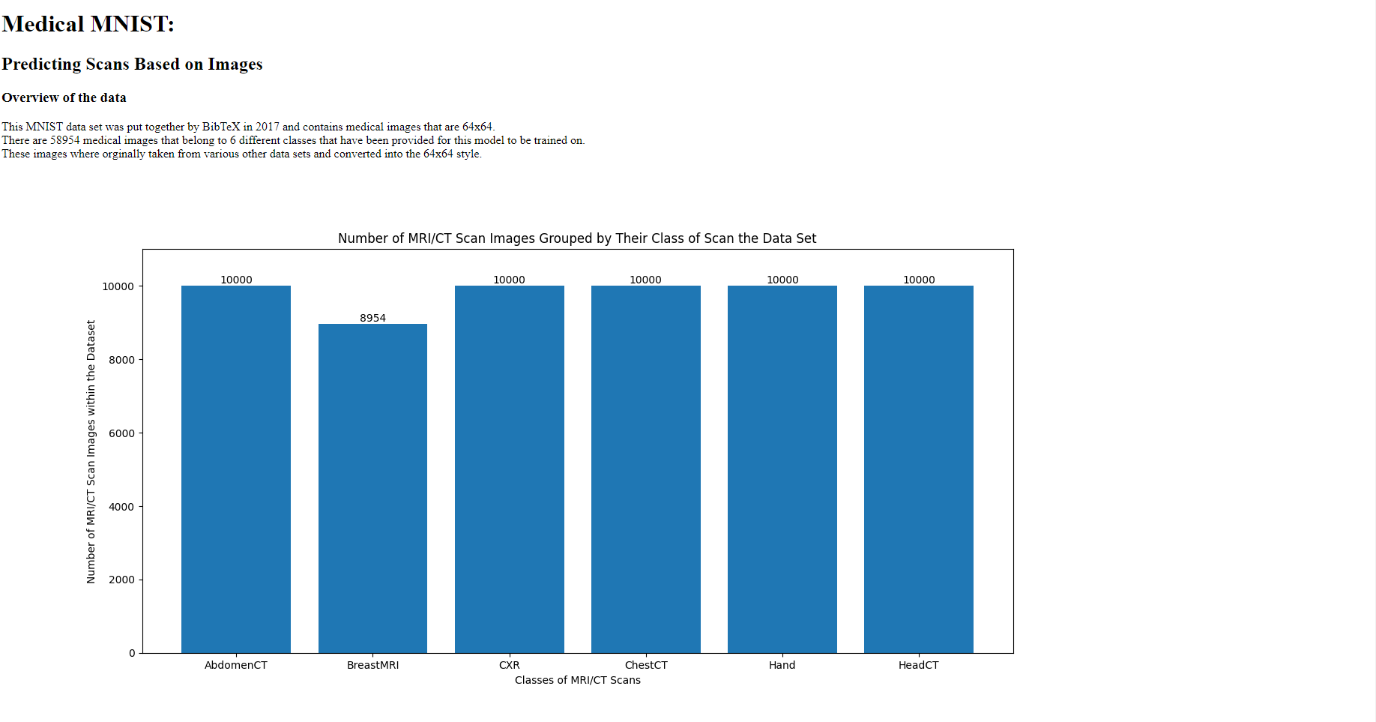

Slide 7
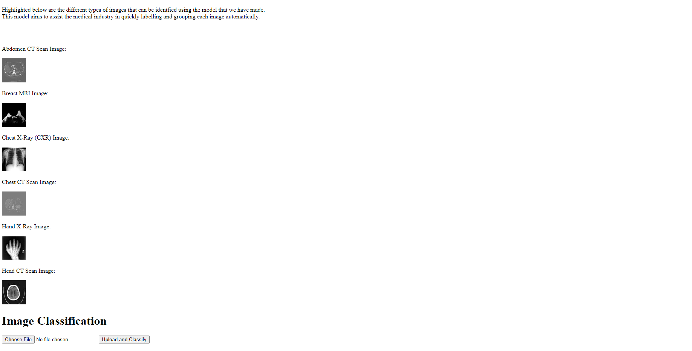

Slide 8
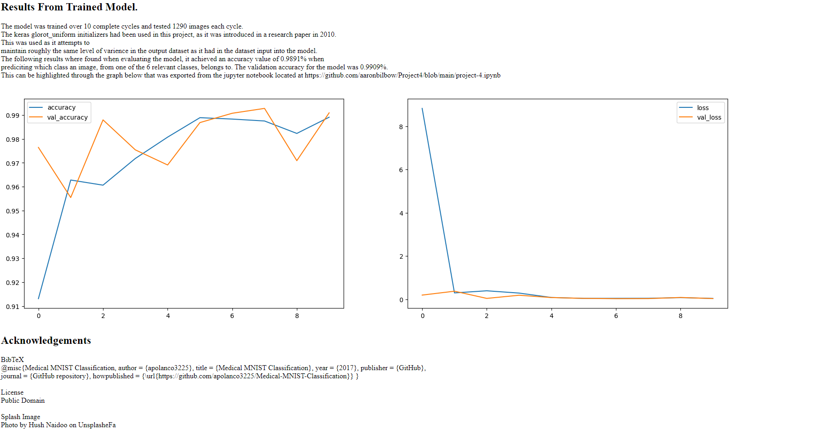

Slide 9
Acknowledgements
BibTeX @misc{Medical MNIST Classification, author = {apolanco3225}, title = {Medical MNIST Classification}, year = {2017}, publisher = {GitHub}, journal = {GitHub repository}, howpublished = https://github.com/apolanco3225/Medical-MNIST-Classification}
License Public Domain
Splash Image Photo by Hush Naidoo on UnsplasheFa

